Slide 1
Wine Quality Analysis Using Machine Learning
Presented By:
Nikita Sali
Guided By:
Ashwini Kakade

Slide 2
Agenda
INTRODUCTION
PROBLEM STATEMENT
DATASET
ML ALGORITHMS

Slide 3
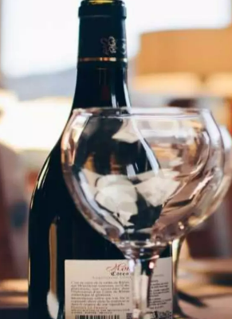
Introduction
Wine is a drink made from fermented grapes and other fruits, with varying alcohol levels. Assessing its quality and safety is challenging and expensive. Our model simplifies this by predicting analysis outcomes, making the process cheaper and more efficient.

Slide 4

Problem Statement
In the wine industry, the assessment of wine quality and safety through laboratory testing is laborious and costly due to the multitude of analytes and residues to be monitored. This complexity hampers efficiency and increases operational expenses. However, by leveraging predictive analysis through our application, we aim to streamline this process, making it more cost-effective and less reliant on extensive human intervention.

Slide 5
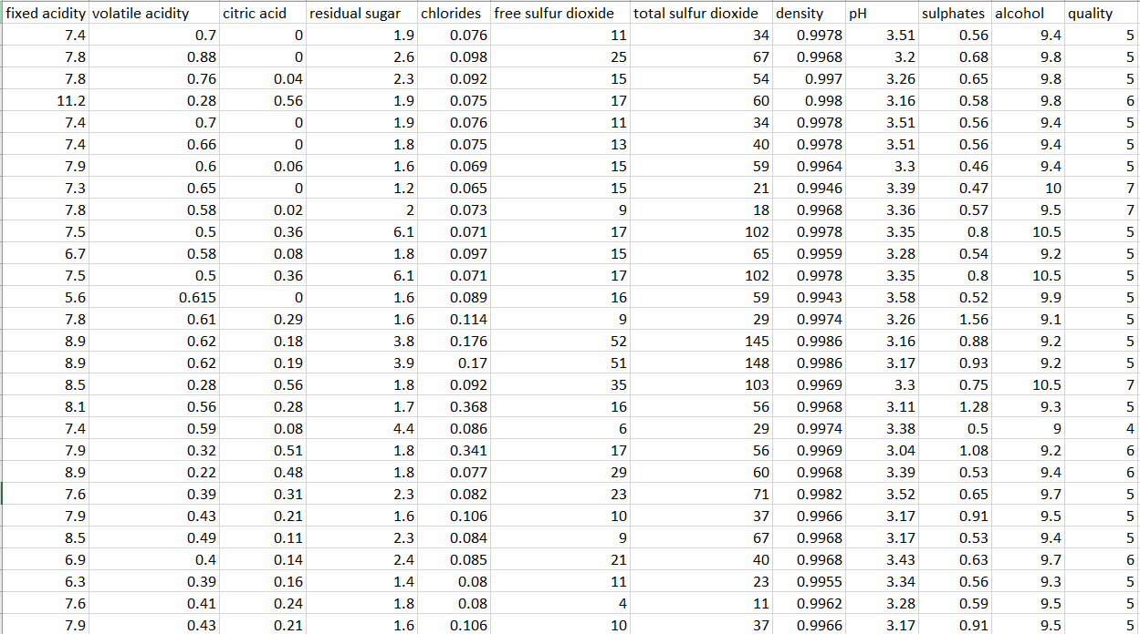
Dataset

Slide 6
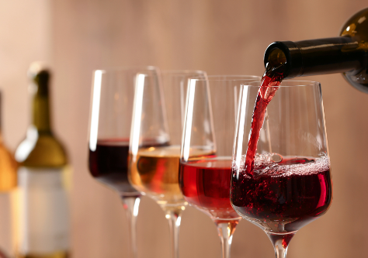
About Dataset
Dataset Name: winequality-red.csv
Shape of dataset: (1599,12)
Missing values : 0
Input columns: fixed acidity, volatile acidity, citric acid, residual sugar, chlorides, free sulfur dioxide, total sulfur dioxide, density, pH, sulphates, alcohol
Output column: quality
Splitting dataset into training and testing
Using test size = 0.2

Slide 7
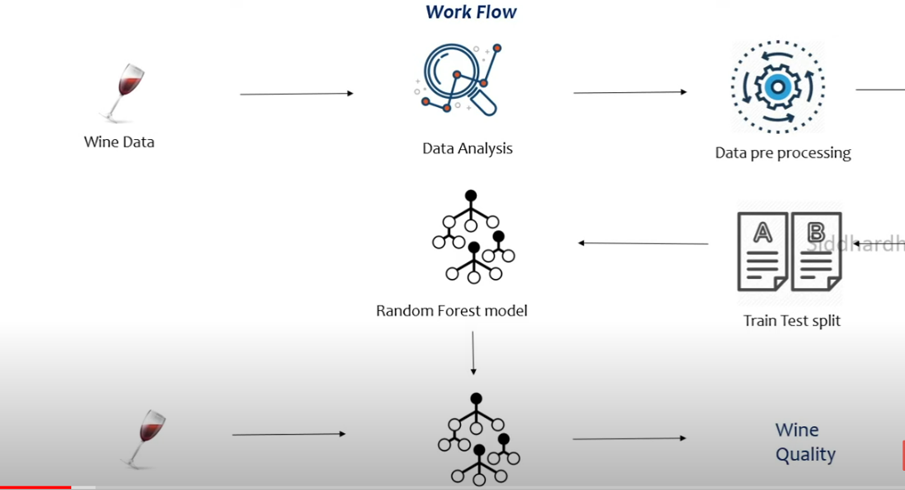

Slide 8
ML Algorithms Used :
As the output column of our dataset is in categorical format so we had decided to use classification algorithms.
We have decided to use below algorithms in our dataset
Random Forest Classifier
Decision Tree Classifier
Kneighbors Classifier

Slide 9
Random Forest
Random forest is a method of classification, regression and other tasks, that operate by constructing a multitude of decision trees at training time and outputting the class that is the mode of the classes (classification) or mean prediction (regression) of the individual trees.
Following are some of the features of random forest algorithm:
It runs efficiently on large databases.
It gives estimates of what variables are important in the classification.

Slide 10
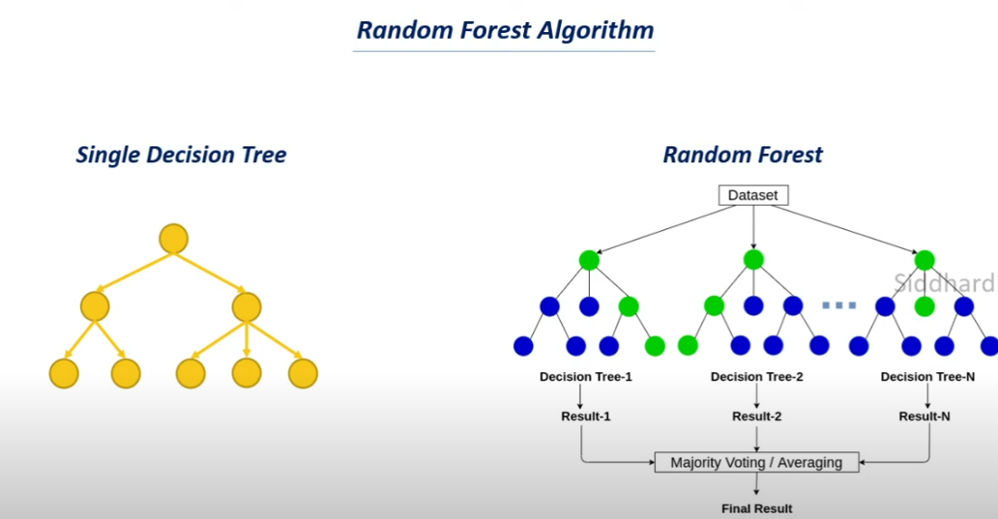
Random forest

Slide 11
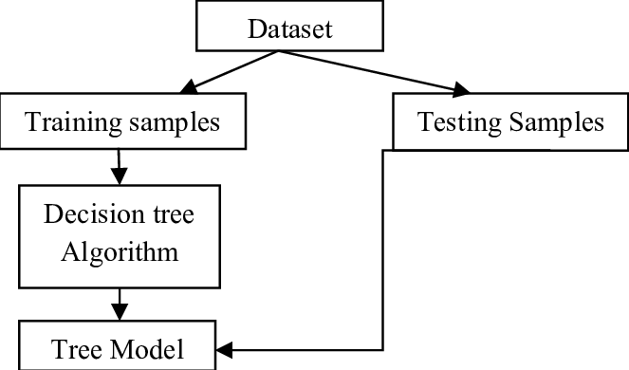
Decision Tree

Slide 12
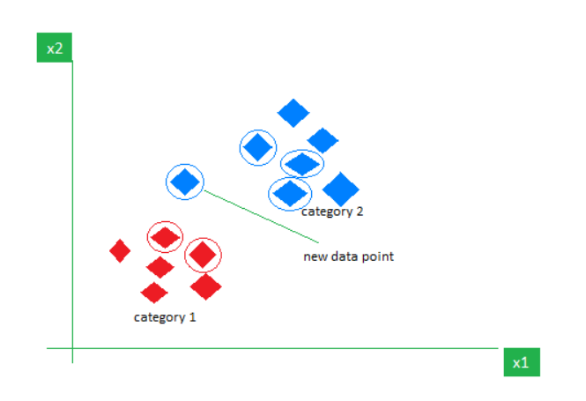

Kneighbour’s Classifier
Steps to follow:
Calculate distances
Select K-nearest neighbour
Majority Voting (Classification)

Slide 13
Comparison Table
ALGORITHM NAME | ACCURACY SCORE
Random Forest Classifier | 0.921875
Decision Tree Classifier | 0.896875
K Neighbors Classifier | 0.871875

Slide 14
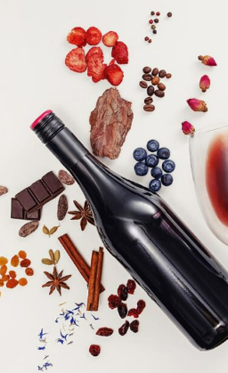
REFERENCES
[1]“The Classification of White Wine and Red Wine According to Their Physicochemical Qualities,” Int. J. Intell. Syst. Appl. Eng., vol. 4, no. SpecialIssue-1, pp. 23–26, 2016.
[2] E. Summary, W. P. Monitoring, W. Quality, W. Safety, and W. Complexity, “Wine Analysis : from ‘Grape to Glass’ An analytical testing digest of the wine manufacturing process,” 2016.
[3] A. Ghosh, “Project Report : -Red Wine Quality Analysis Final 3 . An empirical Red Wine Quality Analysis of the Portuguese ‘ Vinho Verde ’ wine,” no. December 2017, 2018.
[4]Datasetdownloadlink: https://www.kaggle.com/datasets/uciml/red-wine-quality-cortez-et-al-2009
[5] P. Model, L. Regression, and R. Studio, “Building and Evaluating a Predictive Model w/ Linear Regression in RapidMiner Studio,” 2018.

Slide 15
Thank you

